Slide 1
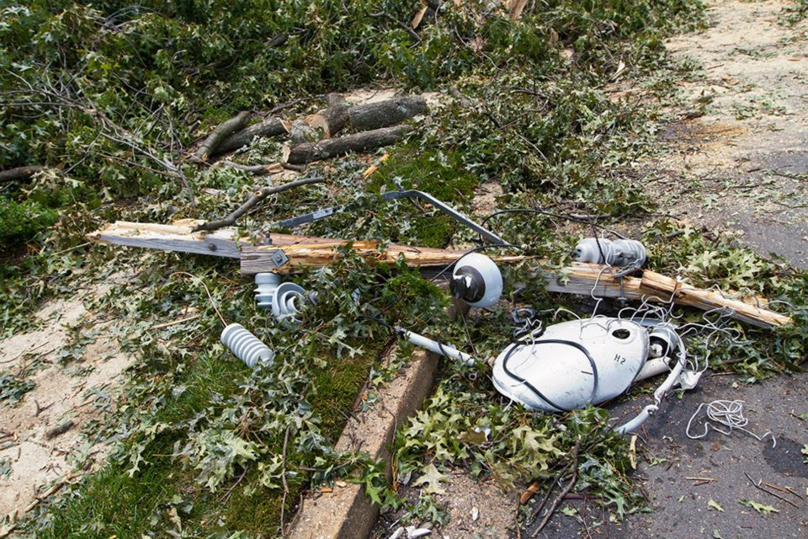
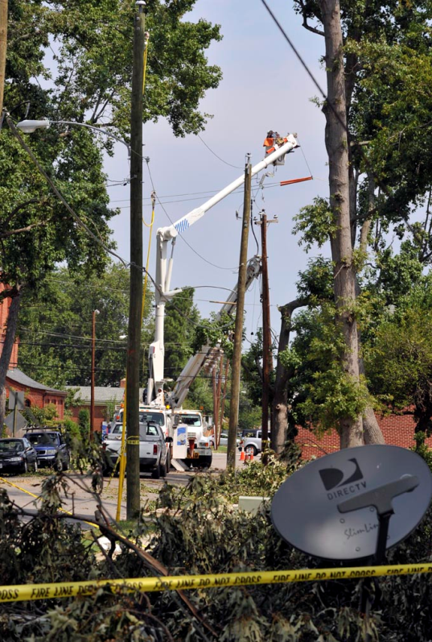
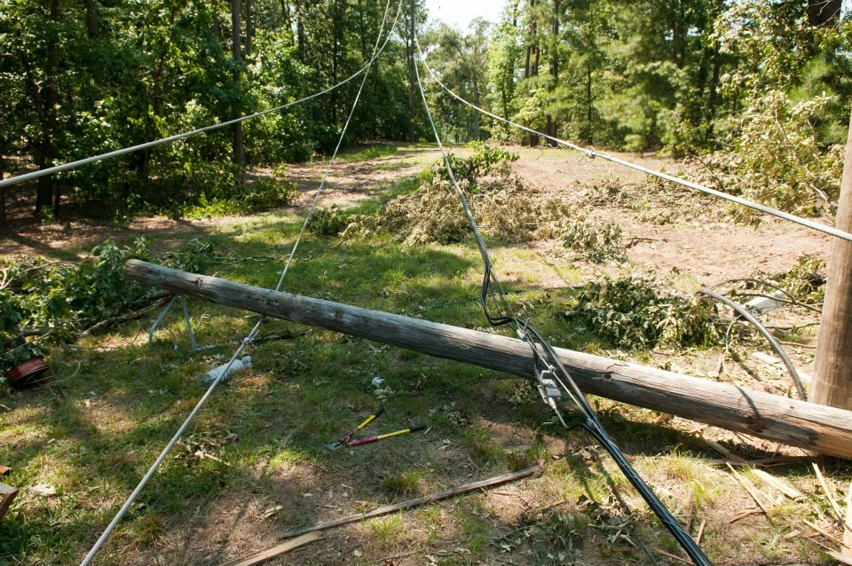
Dominion Storm Preparation & Planning
Arlington Civic Federation
November 13, 2012

Slide 2

Dominion Safety Campaign

Slide 3
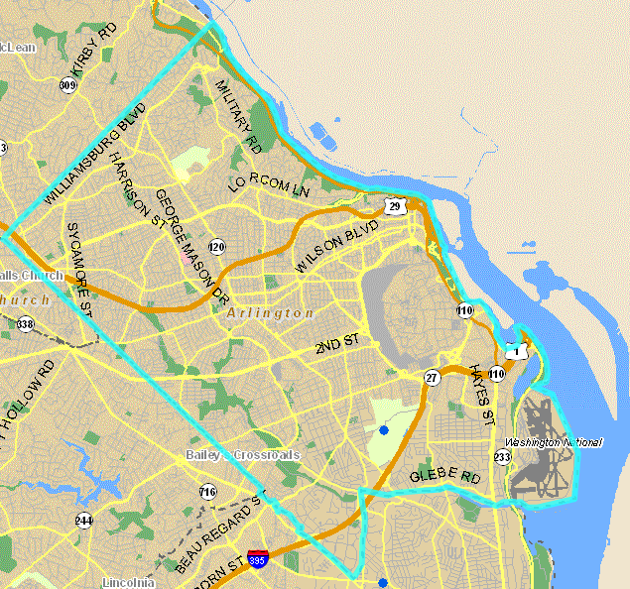
Local office
Daily Staffing
84,000 Customers in Arlington County
Served by Dominion’s Alexandria /Arlington Local Office
  30 Bucket Trucks Onsite
  70 Line Crews
  Eight & Ten-hour work shifts
  Overnight Coverage

Slide 4
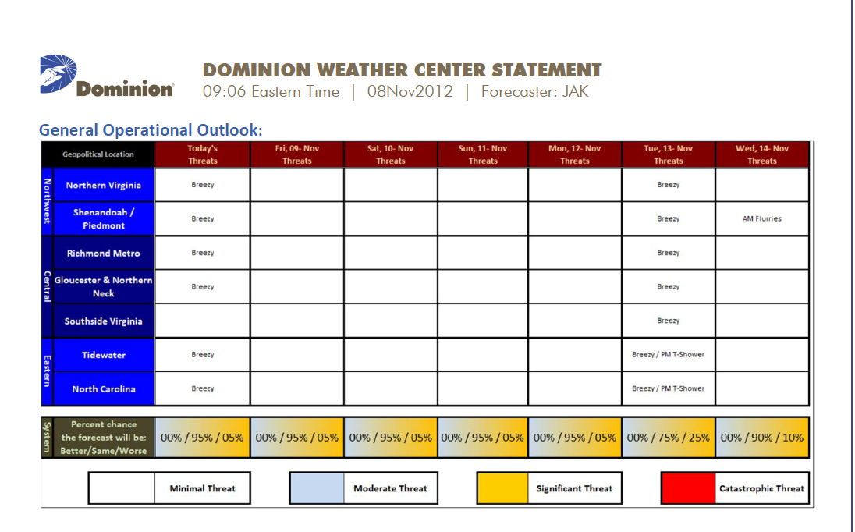
Weather Matters
Weather Forecast Updates
  Internal meteorologists monitor potential impact to Dominion Service Territory

Slide 5
Daily Operations to Storm Planning
Planning for Major Events, including:
    Storms
    National Security
  Resource & Restoration Management
  Coordination with local and state
  emergency management
  and jurisdictional partners
Emergency Preparedness Center
3 Regional Operations Centers
34 Local Offices

Slide 6
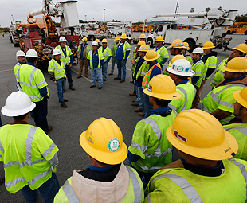
Planning and Preparation
System Wide Conference Calls
  Allows teams in the different regions to coordinate preparation efforts
Contact Suppliers
  Advanced procurement of equipment &
  materials
Coordinate with Neighboring Utilities
  Evaluate need for mutual assistance

Slide 7
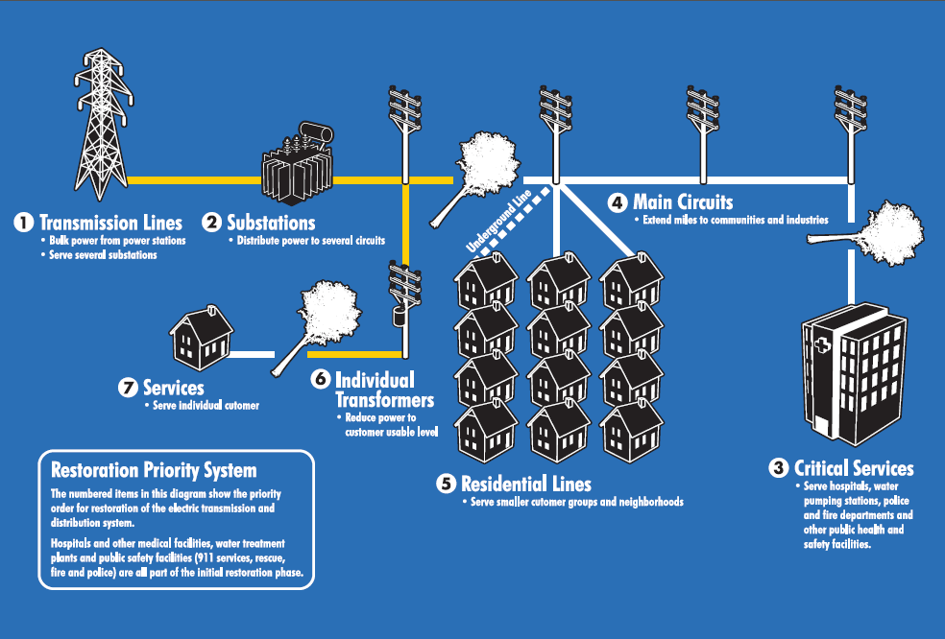
Restoration and Recovery Strategy
7
Notes:
Question: How do we prioritize restoration?

Slide 8
Restoration Priority given to Critical
Public Safety & Health Facilities

Slide 9
Storm Preparation Tips for Homeowners
Have a 3-day supply of water and non-perishable foods
Keep battery powered radio and flashlights in your home
Make sure laptops and cell phones are fully charged
Maintain a fully stocked first-aid kit
Refill any vital prescriptions before storm hits

Slide 10

Our boots don’t come off until your lights are back on.
Report Outages at : 1-866-DOM-HELP (1-866-366-4357)

